Slide 1
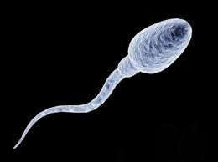
Specialised Cells
Lesson Objectives:
Recall that multicellular organisms must undergo cell differentiation
Compare types of specialised cells found in plants and animals
Explain how specialised cells are adapted for their function in tissues, organs and whole organisms
Starter – LO1:
What do the following key words mean?
multicellular, differentiation, specialised
Review:
Be prepared to share your ideas

Slide 2
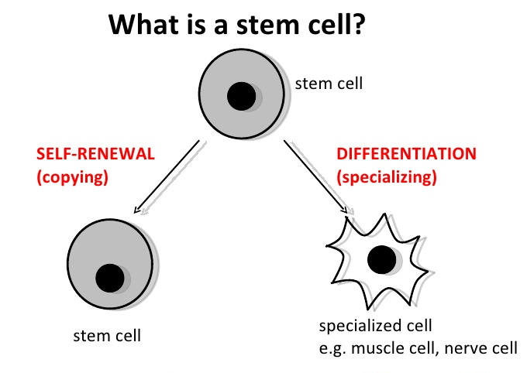

Slide 3
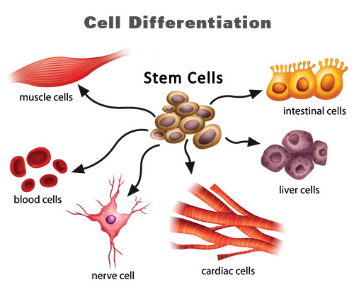
Cell differentiation…
Multicellular organisms must undergo cell differentiation to go from one fertilised cell, into many different and specialised cells
They do this by gaining different sub-cellular structures:

Slide 4
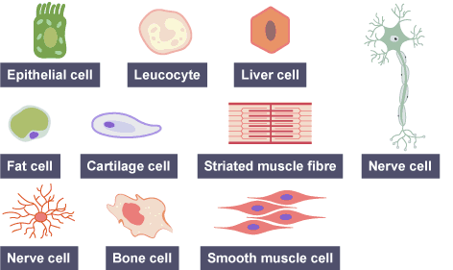
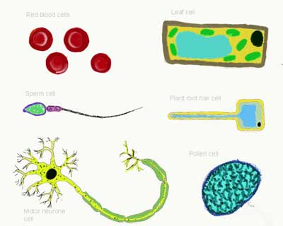

Slide 5
Cell Specialisation…
Many cells in multicellular organisms are specialised. They have specific roles in the organism of which they are part. Their structure is adapted to their function, this is known as adaptation. They are often grouped together with other similar cells in tissues.

Slide 6
LO: Recall that multicellular organisms must undergo cell differentiation
To do:
What type of cell do all cells start as?
Define the term cell differentiation.
List 5 examples of specialised cells.
Define the term adaptations in cells.
Review:
Be prepared to share your ideas

Slide 7
LO: Compare types of specialised cells found in plants and animals
Task – circus activity
The following next slides are a series of information sheets about different types of specialised cells, found in animals and plants
Find the information about each cell type
Fill in your table as you go
Review:
Discuss and question with partner different cell types

Slide 8
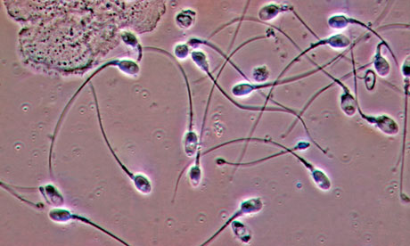
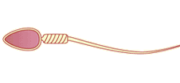
Sperm cells
Sperm Cell
Structure:
Long tail and streamlined head
Contains lots of mitochondria
The head contains enzymes which allow it to digest into an egg cell and join with it
Function:
To carry the father’s genetic information (DNA) to the egg for fertilisation

Slide 9
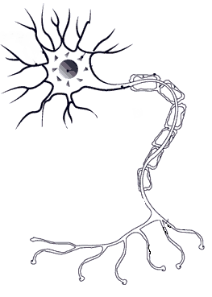
Nerve cells
Nerve Cell
Structure:
Extremely elongated (long) cells
They have many branches at each end, to connect to other nerves
The long axis (main branch) is covered in fat to prevent the electrical impulses affecting the surrounding parts of your body.
Function:
To carry nerve impulses (electrical signals) around your body, rapidly

Slide 10
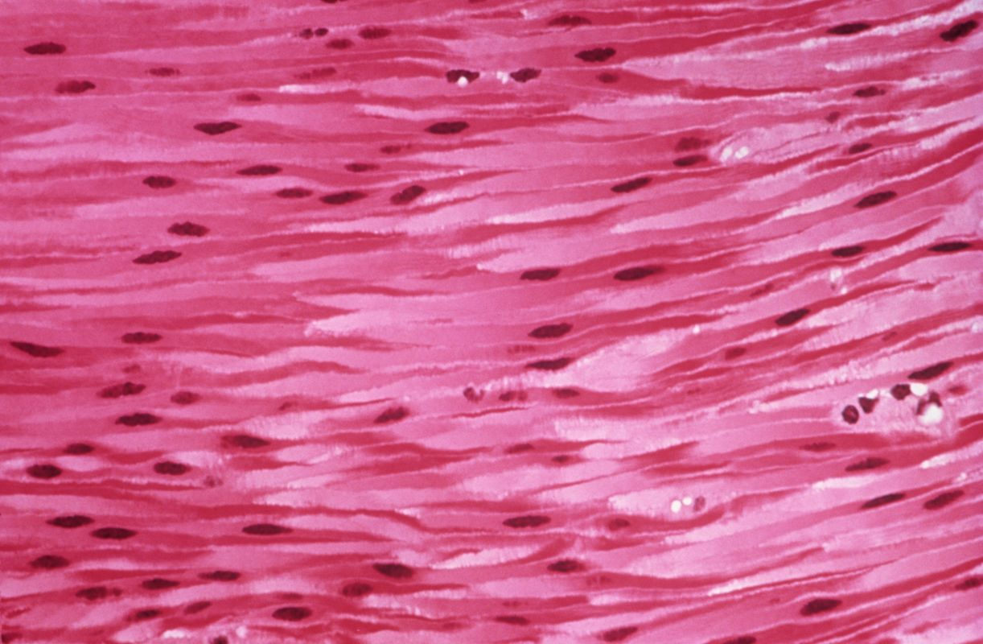
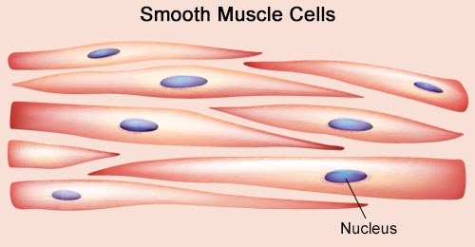
Root hair cells
Muscle Cell
Structure:
The cells are very long
Contain lots of mitochondria
Function:
Contract quickly, to allow for efficient movement
Mitochondria transfer this energy needed for contraction

Slide 11
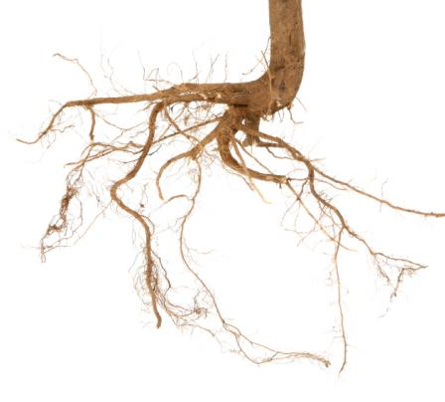
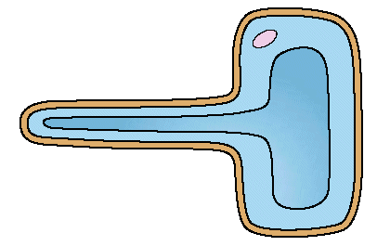
Root hair cells
Root Hair Cell
Structure:
Large surface area to absorb lots of water
Thin cell wall to allow water to pass through easily
Doesn’t contain any chloroplasts unlike all other plant cells
Function:
Absorbs minerals and water from soil

Slide 12
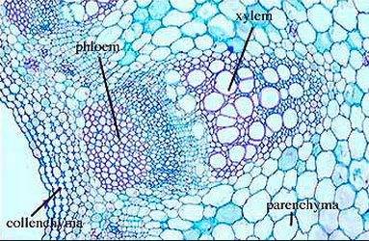
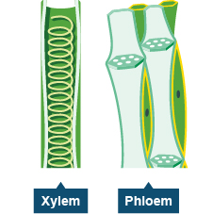
Root hair cells
Phloem Cell
Structure:
A tube structure that has columns of living cells
The cell walls form small holes at the end of the cell to allow movement of substances
Function:
Transport food and substances from the stems to growing and storage tissues

Slide 13
Root hair cells
Xylem Cell
Structure:
No cytoplasm and no end walls – hollow in the centre (the lumen) forming a continuous tube
The cells are strengthened by lignin, a tough waterproof substance
Function:
Transport water in the plant
Support the plant

Slide 14
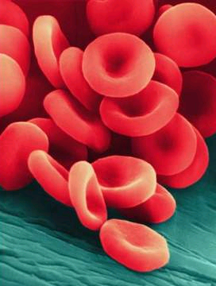
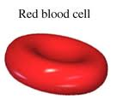
Red blood cells
Red Blood Cell
Structure:
Large surface area
Small size
Contains haemoglobin which binds with oxygen
Has no nucleus to make room for more oxygen
Function:
Carries oxygen from the lungs to the body and carbon dioxide from the body back to the lungs

Slide 15
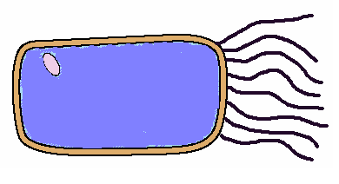
Ciliated Cell
Structure:
They line all the air passages down to the lungs
They have tiny hairs called cilia
Function:
Designed to stop lung damage
Hairs sweep mucus with trapped dust and bacteria back up the throat to be swallowed.
If you smoke then the hairs die and the mucus builds up leading to health problems
Nucleus
cilia

Slide 16
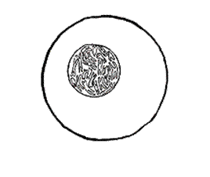
Egg (Ovum) Cell
Egg Cell
Cytoplasm containing yolk
Structure:
Contains a yolk that acts as a food source for the developing embryo (baby) when fertilised
Much larger than other animal cells (look at the size of the sperm next to it!)
Found in the ovaries
Function:
Carries the mother’s DNA
Layer of jelly
Nucleus

Slide 17
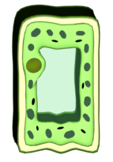
Palisade Cell
Palisade Cell
Structure:
Found in the top of a leaf
Tall and has a large surface area to catch as much sunlight as possible
Packed with chloroplasts to absorb sunlight
Function:
to carry out photosynthesis
to help make plant food.

Slide 18
LO: Explain how specialised cells are adapted for their function in tissues, organs and whole organisms
Type of Cell | Animal or Plant | Function | Adaptations to carry out functions
Review:
Be prepared to share your ideas

Slide 19
Practise Questions
Q1) What is cell differentiation?
Q2) a) What is the function of a nerve cell?
b) Describe two features of a nerve cell that make it specialised for its function
Q3) Muscle cells are likely to contain more mitochondria than skin cells. Explain why

Slide 20
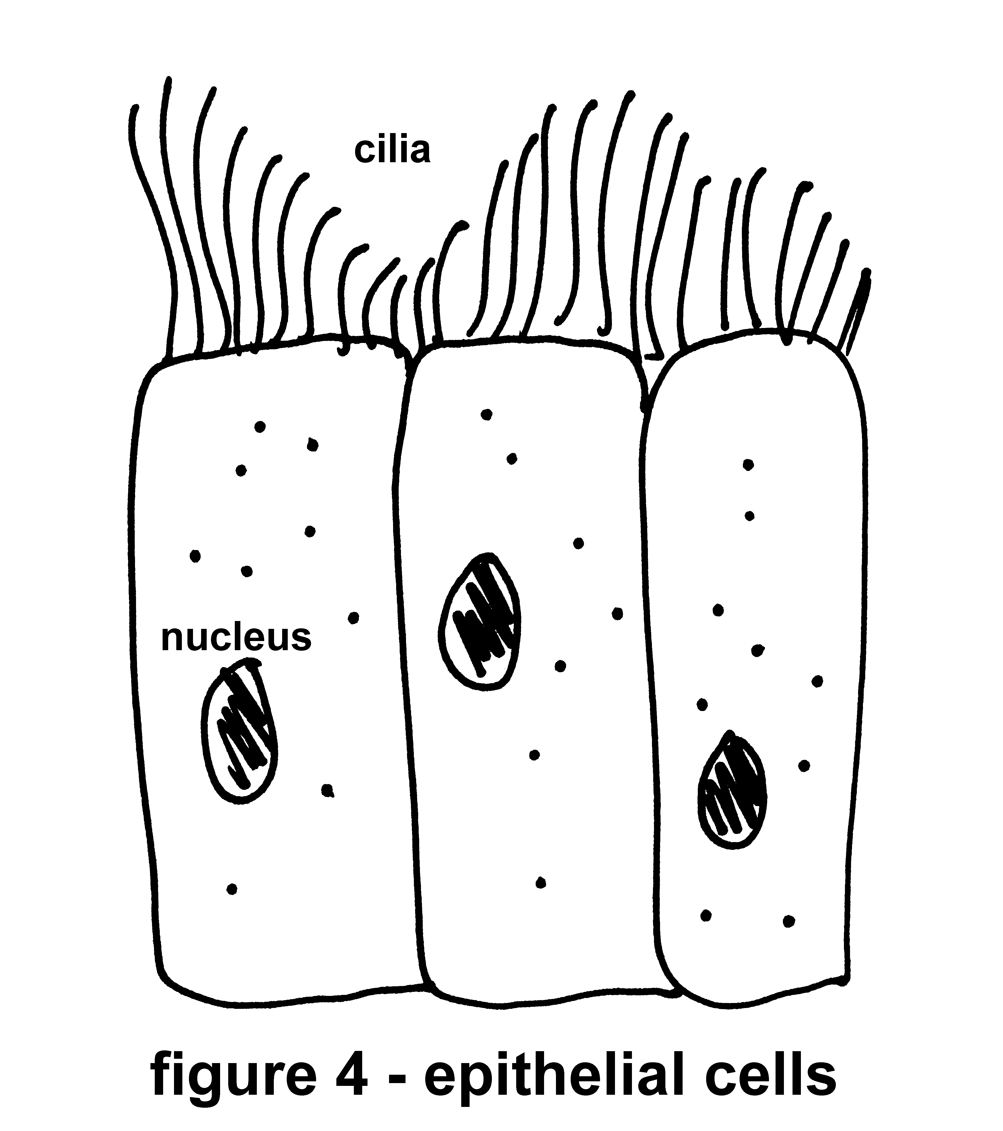
Exam Practise
Q1) A diagram of an epithelial cell from the small intestine of the digestive system is here. It has lots of folds in the cell membrane and lots of mitochondria. These cells line
The inner surface of the small intestine and their function is to absorb food molecules as they move through the intestine. Sometimes this process requires energy.
Use this information and the diagram to suggest two ways in which the structure of these cells helps them carry out their function

